Slide 1
Network : Protocol
Jae Hyeon Kim

Slide 2
Reference
William Stalling, Data and Computer Communications 10/E, Prentice Hall

Slide 3
Protocol Architecture
Need for protocol architecture to transfer data several tasks must be performed
The source must activate communications path or inform network of the identity of the desired destination
The source must make sure that dest. Is prepared to receive data
The file transfer application on source must confirm file mgmt program at destination is prepared to accept and store the file
A format translation function may need to be performed if the formats used on the two systems are different

Slide 4
Function of Protocol Architecture
Breaks logic into subtask modules
Modules are arranged in a vertical stack, so layering
Each layer in the stack performs a subset of functions
Relies on next lower layer for primitive functions
Provides services to the next higher layer
Changes in one layer should not require changes in other layers
A protocol is a set of rules or conventions that allow peer layers to communicate, the key features of a protocol are:
Syntax : format of data blocks
Semantics : control information for coordination
Timing : speed matching and sequencing

Slide 5
Communication Layer
Communication tasks are organized into three relatively independent layers:
Application layer : contains logic to support applications
Transport layer : provides reliable data transfer
Network access layer : concerned with the exchange of data between a computer and the network to which it is attached

Slide 6
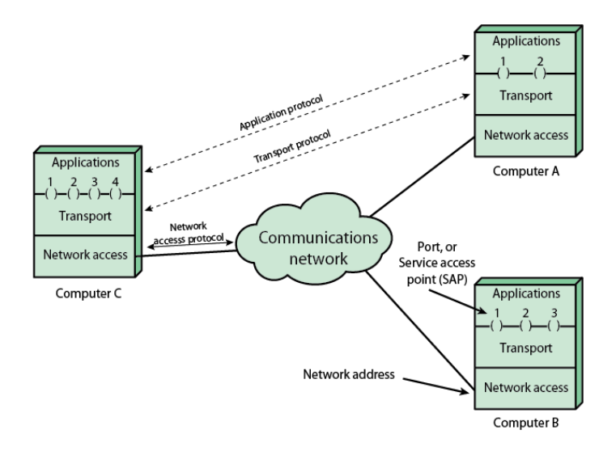
Protocol Architecture and Networks

Slide 7
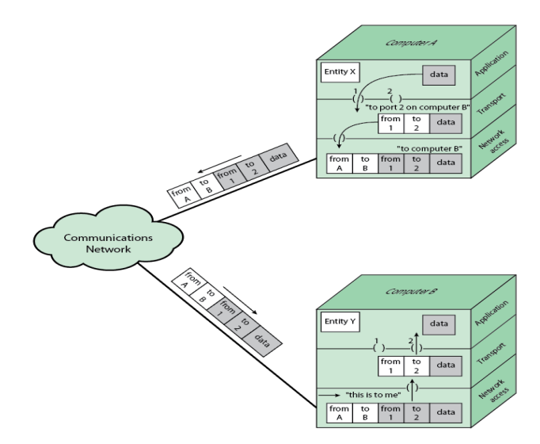
Protocol in a Simplified Architecture

Slide 8
Standardized Protocol Architectures
Required for devices to communicate
Vendors have more marketable products
Customers can insist on standards based equipment
Two standards:
OSI reference model : never lived up to early promises
TCP/IP protocol suite : most widely used
Also : IBM System Network Architecture(SNA)

Slide 9
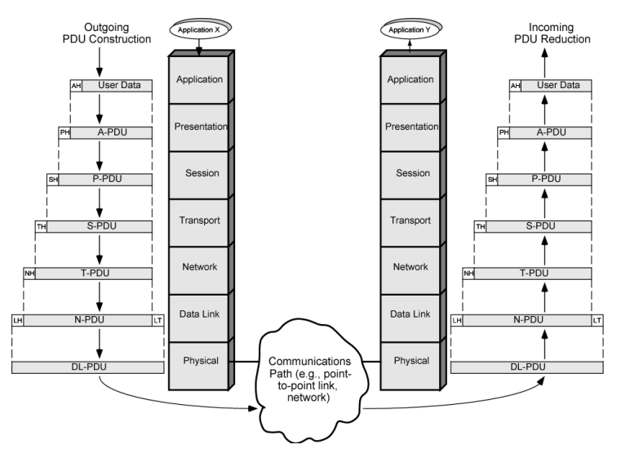
OSI Reference Model

Slide 10
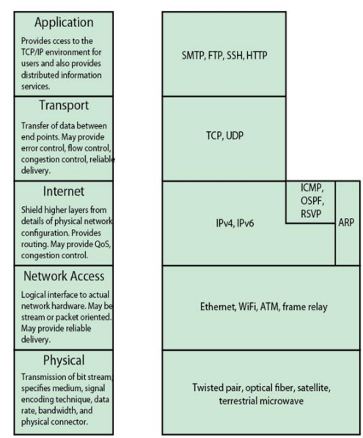
TCP/IP Layers and Example Protocols
Dominant commercial protocol architecture
Specified and extensively used before OSI
No official model but a working one

Slide 11
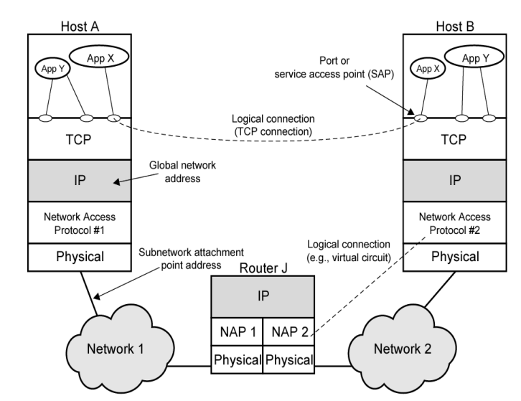
Operation of TCP/IP

Slide 12
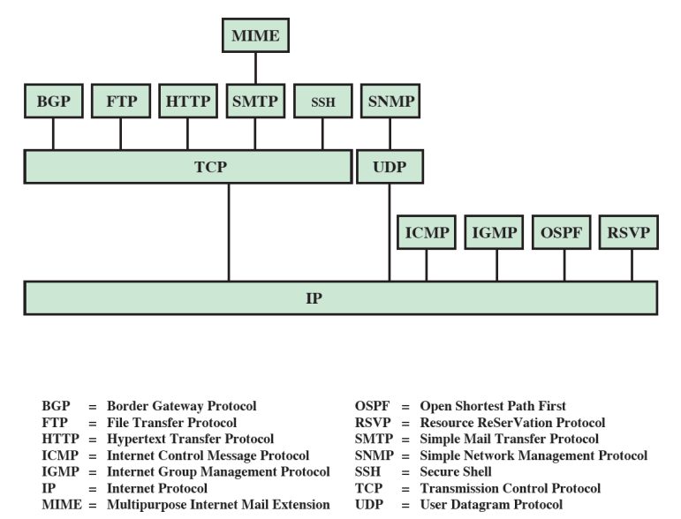
Some Protocols in TCP/IP Suite

Slide 13
Standards
Required to allow for interoperability between equipment
De facto standards e.g.) UNIX, IBM PC, Windows
De jure standards e.g.) OSI 7 layers
Advantages
Ensures a large market for equipment and software
Allows products from different vendors to communicate
Disadvantages
Freeze technology
May be multiple standards for the same thing
Web sites for IETF, IEEE, ITU-T, ISO

Slide 14
Socket Programming
Concept was developed in the 1980s in the UNIX environment as the Berkeley sockets interface
De facto standard application programming interface (API)
Basis for Window Sockets (WinSock)
Enables communications between a client and server process
It may be connections oriented or connectionless
TCP/UDP header includes source port and dest. Port
These port values identify the respective users(applications) while the IP addresses identify the respective host systems

Slide 15
The Socket
Formed by concatenating a port value and an IP address
Unique throughout the Internet
Used to define a communication API
Generic interface for writing programs that use TCP or UDP
Socket parameters
domain {AFUNIX, AF_INET, AF_INET6}
Type {stream, datagram, raw}
Protocol {TCP, UDP, ICMP}
Socket data structure depends on the implementation
Cf) reserved port ≈ well-known port ≈ server port

Slide 16
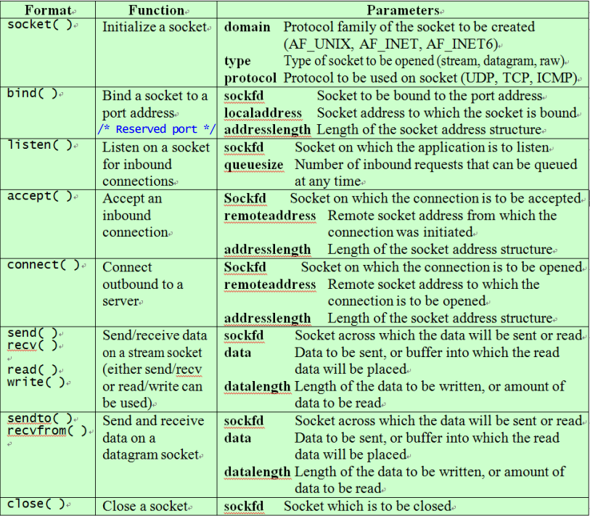
Core Socket Functions

Slide 17
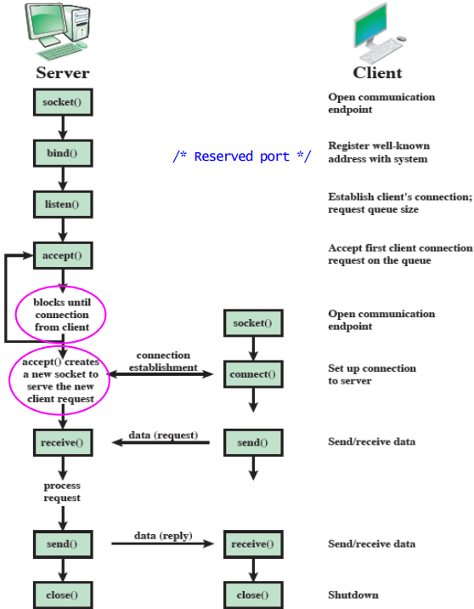
Socket System Calls for Connection-oriented Protocol

Slide 18
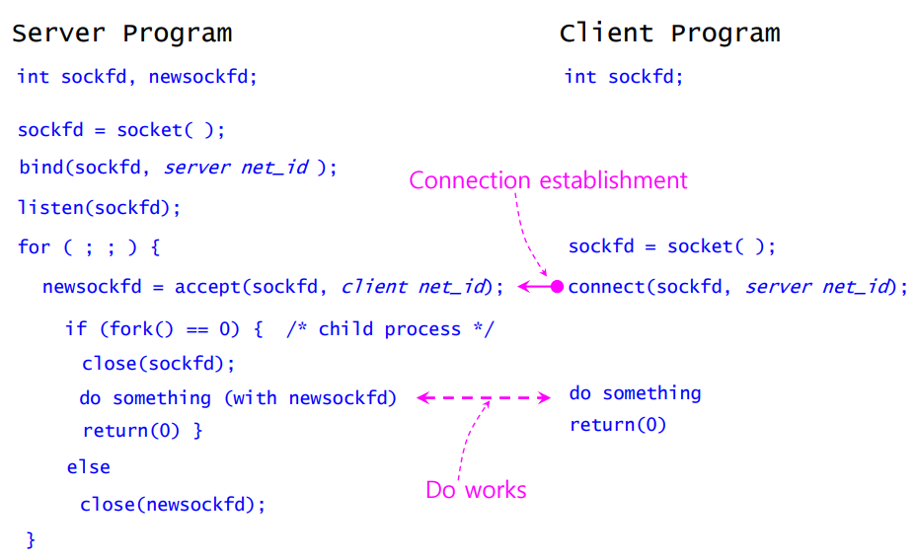
Skeleton of Client/Server Programming

Slide 19
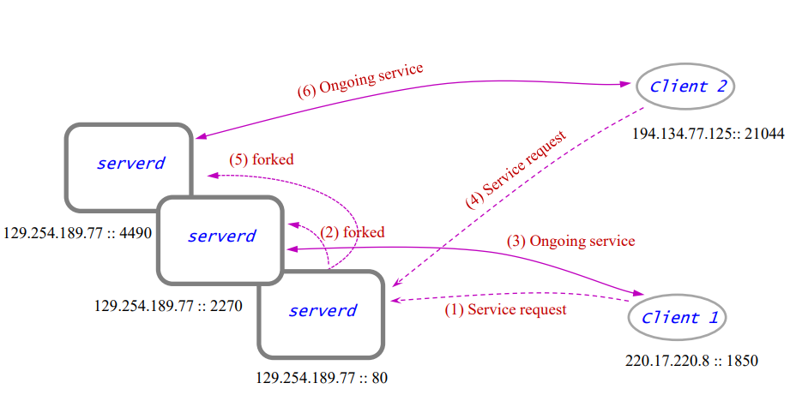
Client/Server Operational View

